Slide 1
Control System Studio (CSS) Overview
Xihui Chen, Kay Kasemir
ORNL/SNS
chenx1@ornl.gov
April. 2013

Slide 2
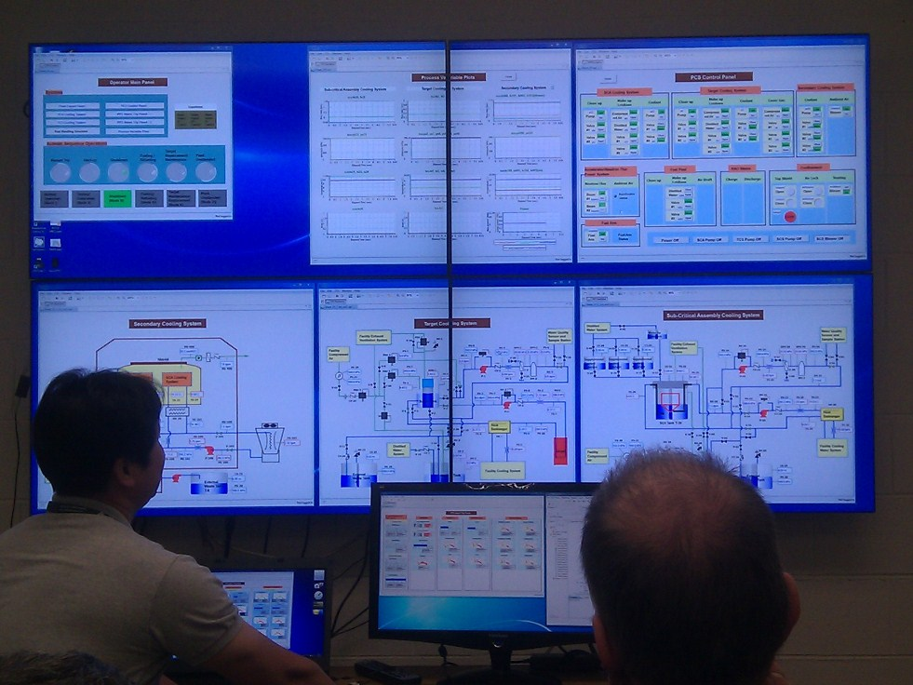
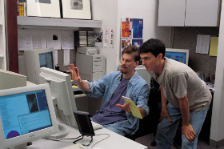
What is CSS?
To End Users:
A Control System Tools Workbench
Integration of various control-system tools into a consistent product
To Developers:
A Framework
An Architecture
A Toolkit
A Collaboration
http://www.citytowninfo.com/images/education-articles/how-to-become-a-software-engineer-2.jpg

Slide 3
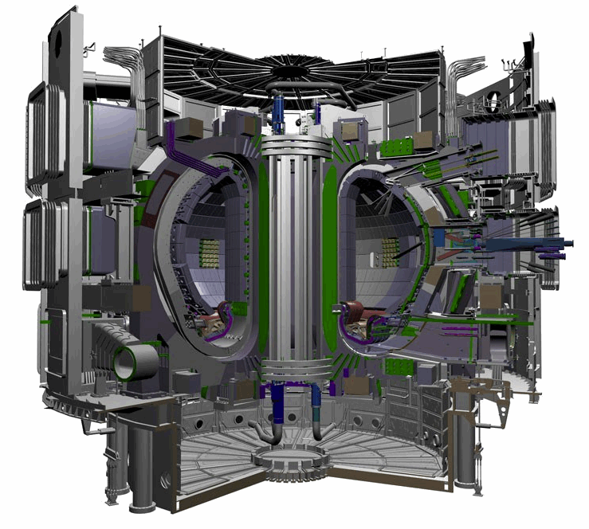
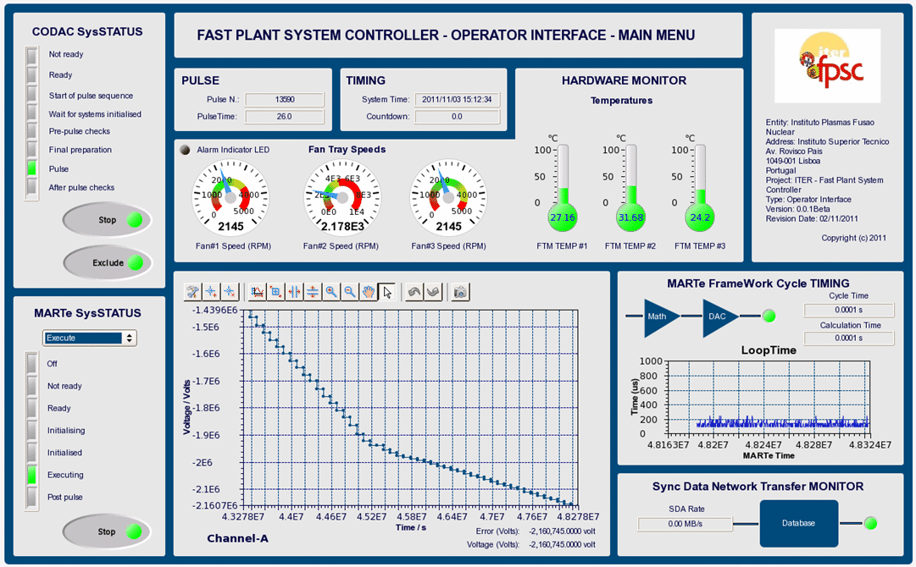
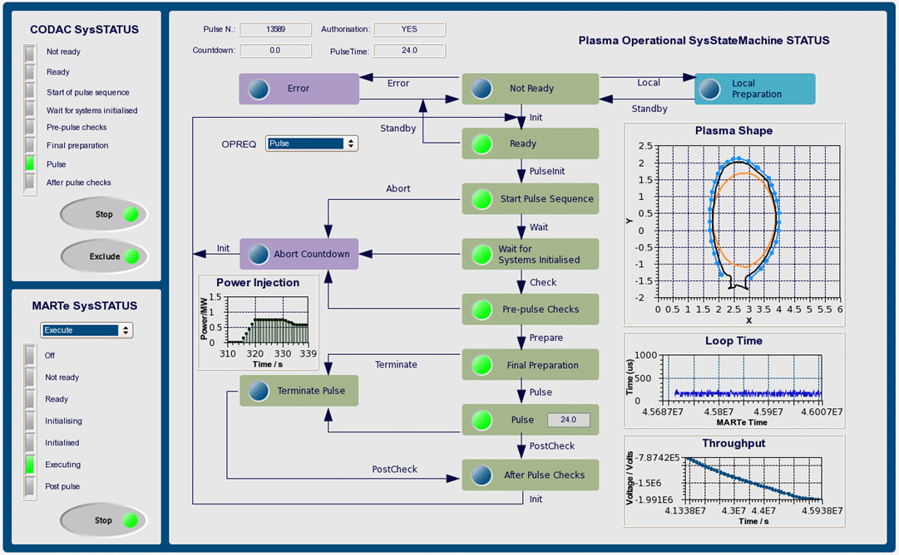
Example: CSS for ITER

Slide 4
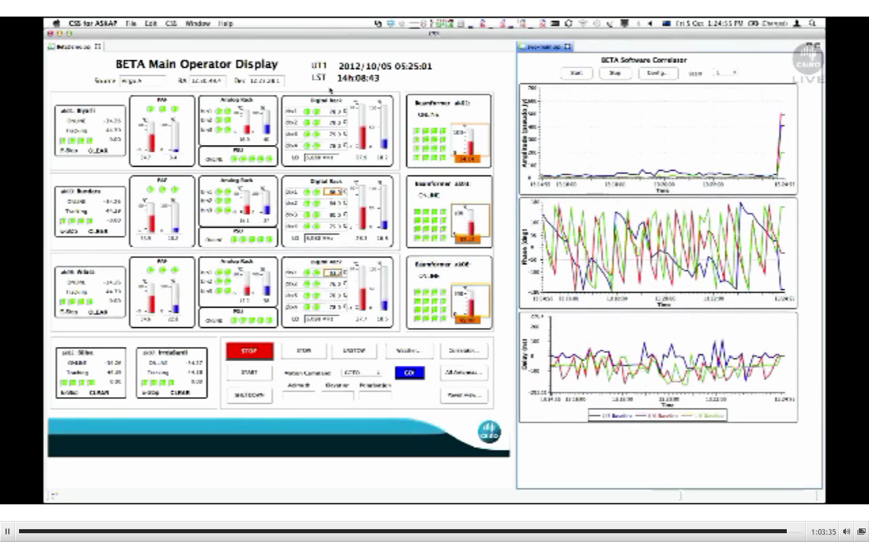
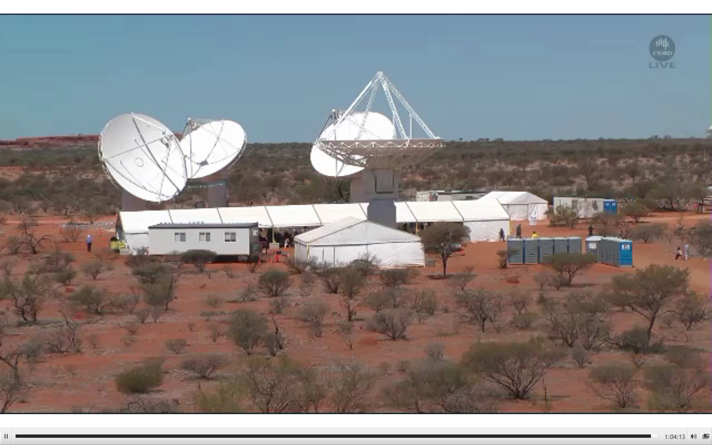

Australian Square Kilometre Array Pathfinder (ASKAP), Oct. 5, 2012
Juan Guzman, http://www.aps.anl.gov/epics/tech-talk/2012/msg02113.php

Slide 5






CSS: A Collaboration
Goal: Portable, better integrated control system tools
Started 2006 between DESY and SNS
Joined by CLS, APS, BNL, ITER, KEK/J-PARC, …
http://cs-studio.sourceforge.net
Wiki, Mailing lists
Source code: https://github.com/ControlSystemStudio

Slide 6


CSS: Control System Architecture
Portable environment (Windows, Linux, OS X)
Free development tools
Plug-Ins, Extension points, Registry
Rich Client Platform (RCP): Windows, menus, help, preferences, online update, …

Slide 7
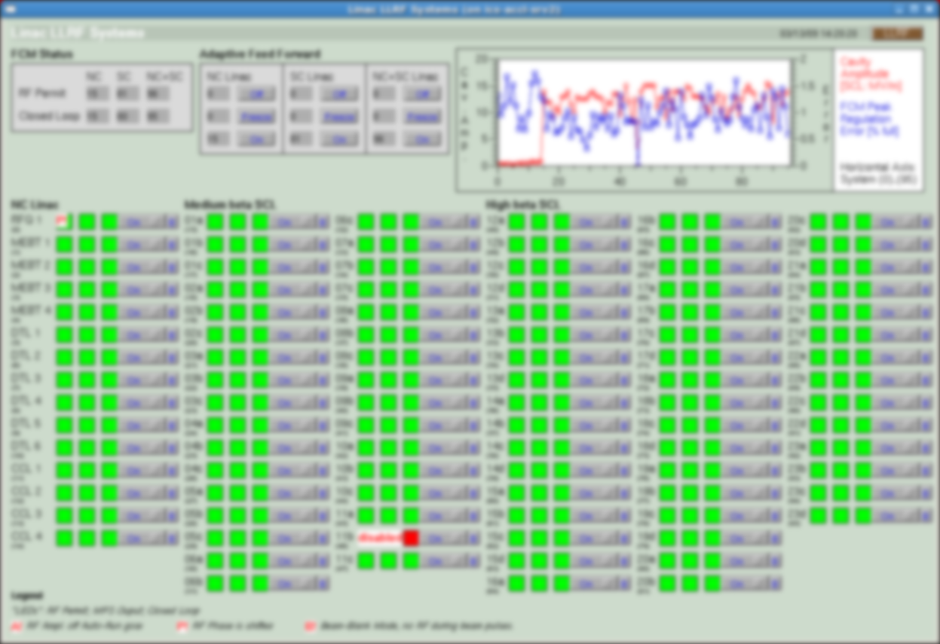
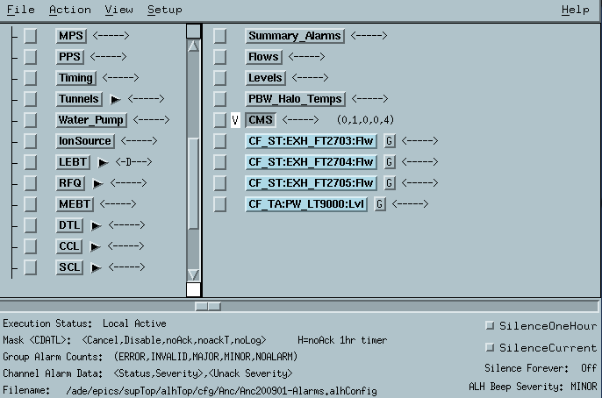
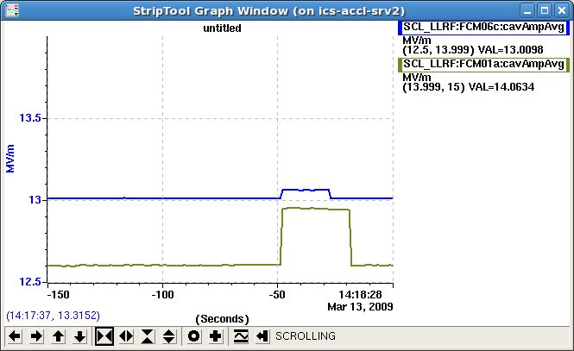
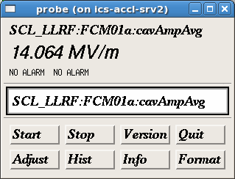
Original EPICS Operator Interfaces
Many disjoint tools
Static layout
Inconsistent Look
Online help?
primarily for Linux/X11

Slide 8
No Integration between Tools
Note PV associated with Alarm
Start StripTool
Add PV to StripTool
Start Archive viewer
Add PV ..

Slide 9
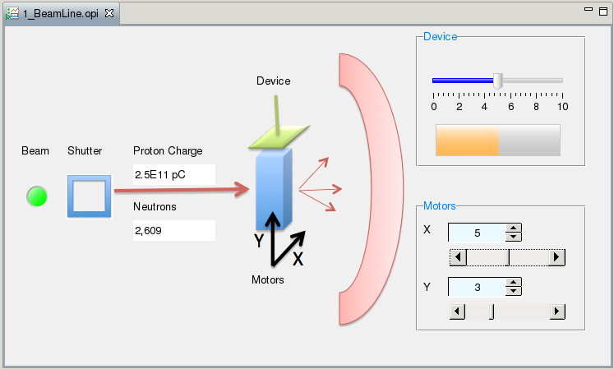
CSS: Assume this Beam Line GUI
How many neutrons do we receive over time?

Slide 10
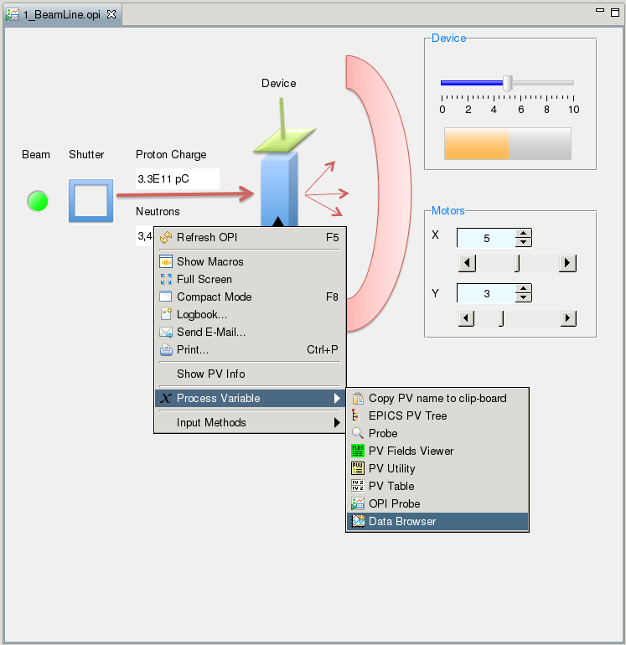
Right click on the neutron count…
‘Data Browser is listed as one of the tools that handle Process Variables…

Slide 11
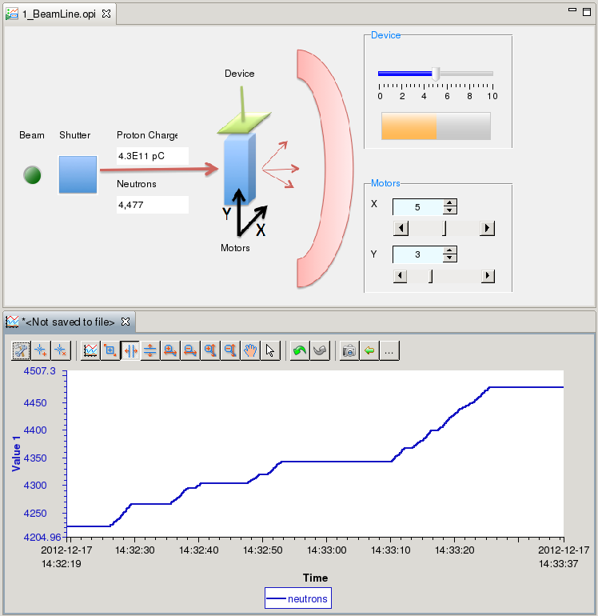
Plotting…
Data Browser started
PV added
Starts showing samples over time
Can also query historic data, if available

Slide 12
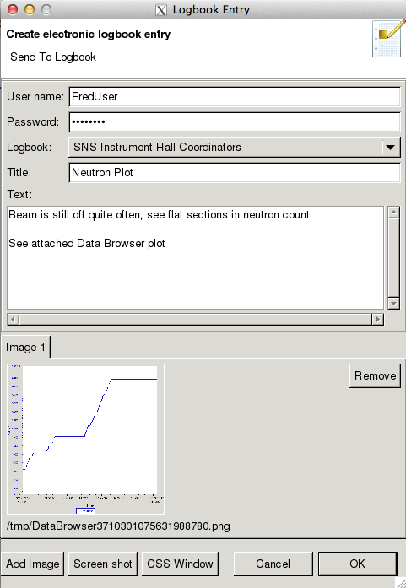
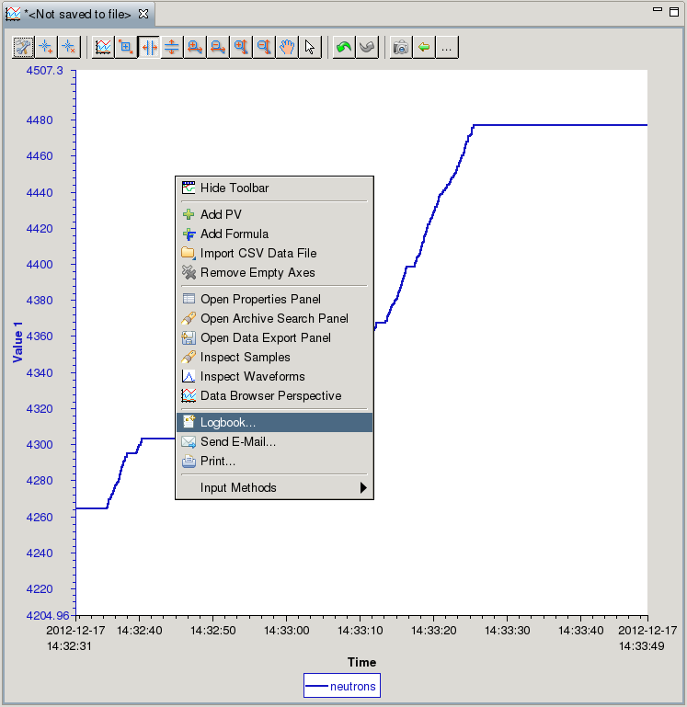
Logbook Entry…

Slide 13
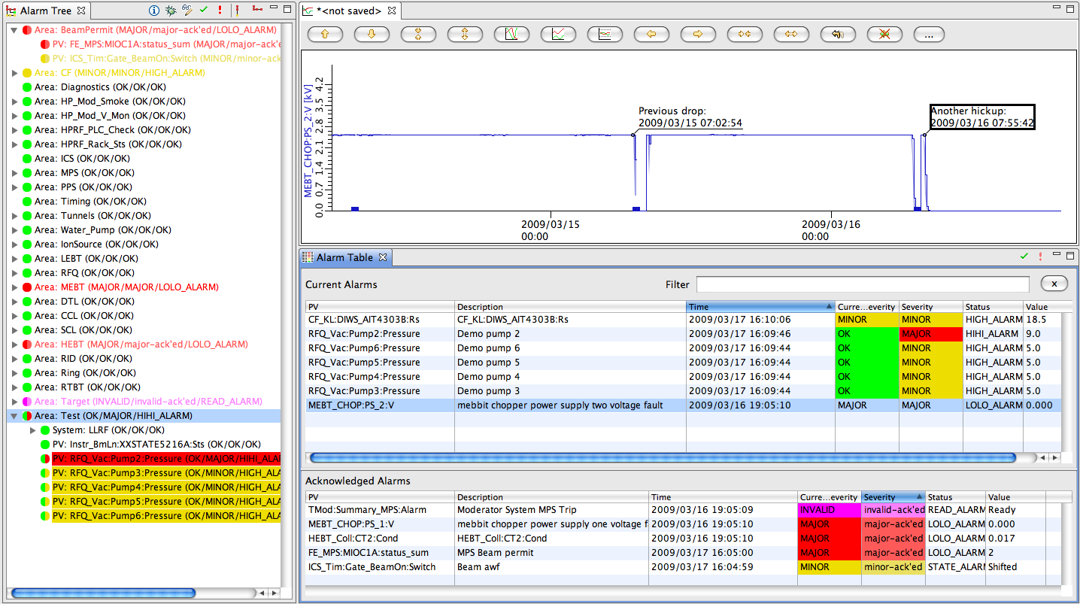
Accelerator Example: React to Alarm
CSS includes an alarm system.
Operator notices an alarm…

Slide 14
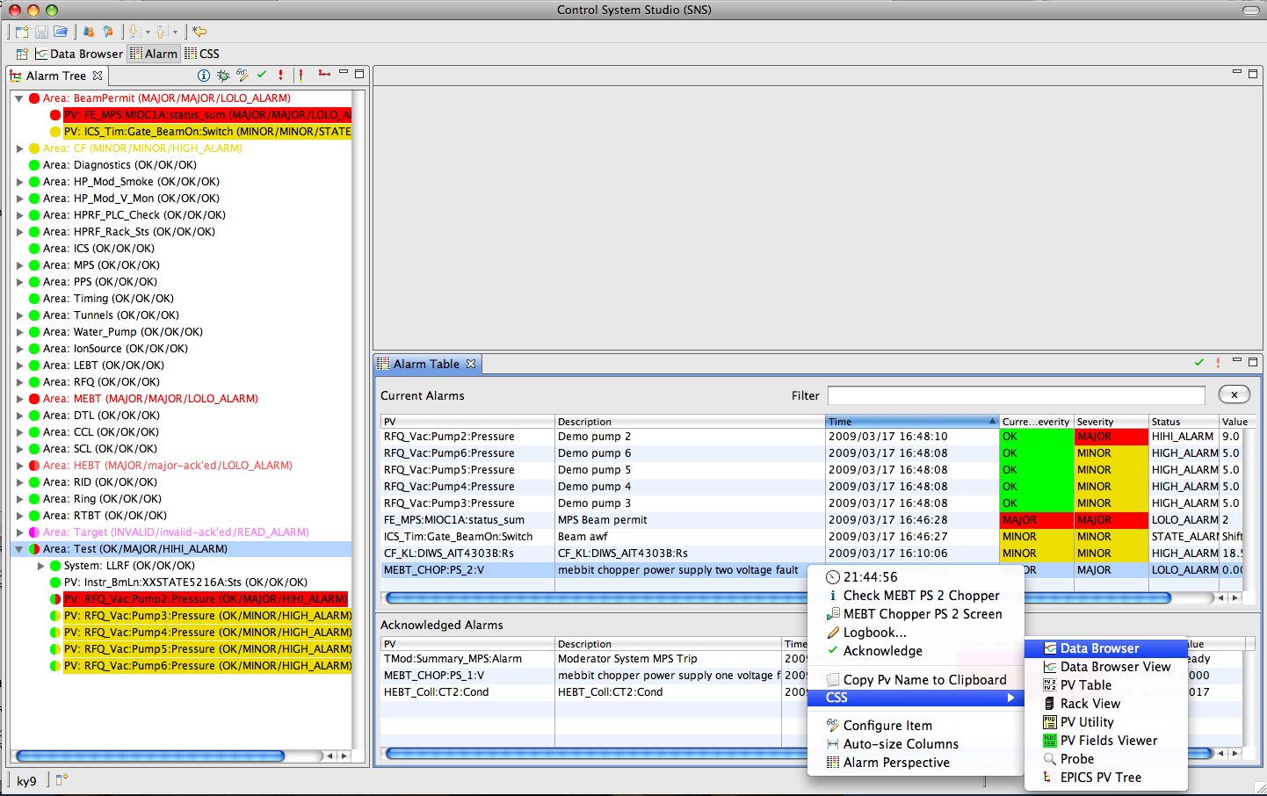
Example Work Flow: React to Alarm.
Context menu of alarm… (“right click”)

Slide 15
Example Work Flow: React to Alarm…
3
2
1
Inspect history of PV, annotate, …

Slide 16
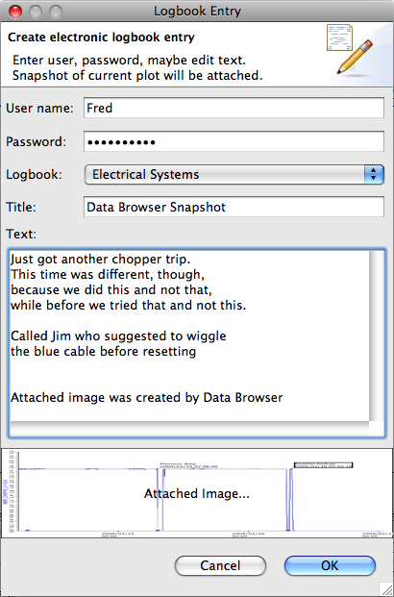
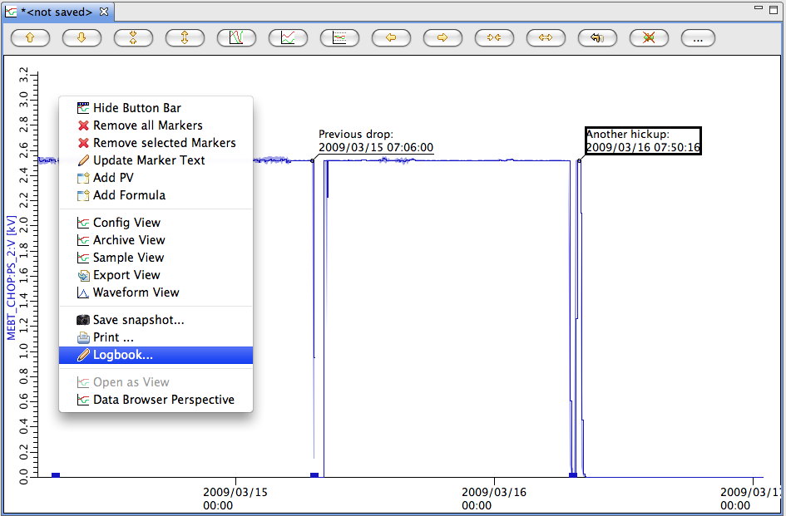
Finally: Make Logbook Entry
After inspecting alarm PV history, post commented plot to E-Log!

Slide 17
CSS: Toolkit
Application Plug-Ins
Strip-Chart: Data Browser
OPI: BOY
Alarms: BEAST
Automation: Scan System
Utilities: Probe, Clock , PV Tree , Psychiatrist
Library Plug-Ins
Control system data types (PV, Sample, …), Life data access, Historic Data Access, Logbook , E-Mail, Authentication, Authorization, …
Extension Points
Life data: Channel Access, Simulated, Local PVs
Historic Data: XML-RPC, RDB, …
Authentication: Kerberos, LDAP, …

Slide 18
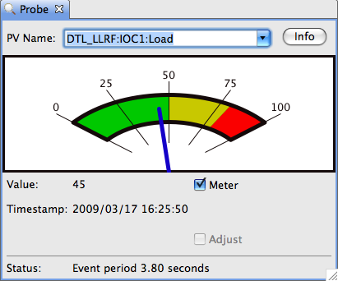
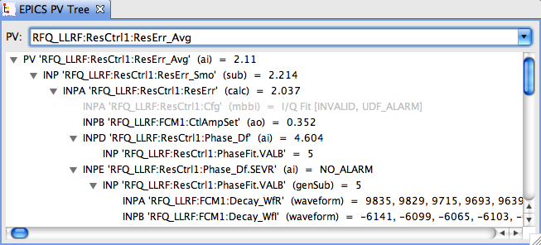
Basic CSS Tools
Probe
Current value of a PV
EPICS PV Tree
Trace PV links
Both:
Resize
PV Name Drop-down history

Slide 19
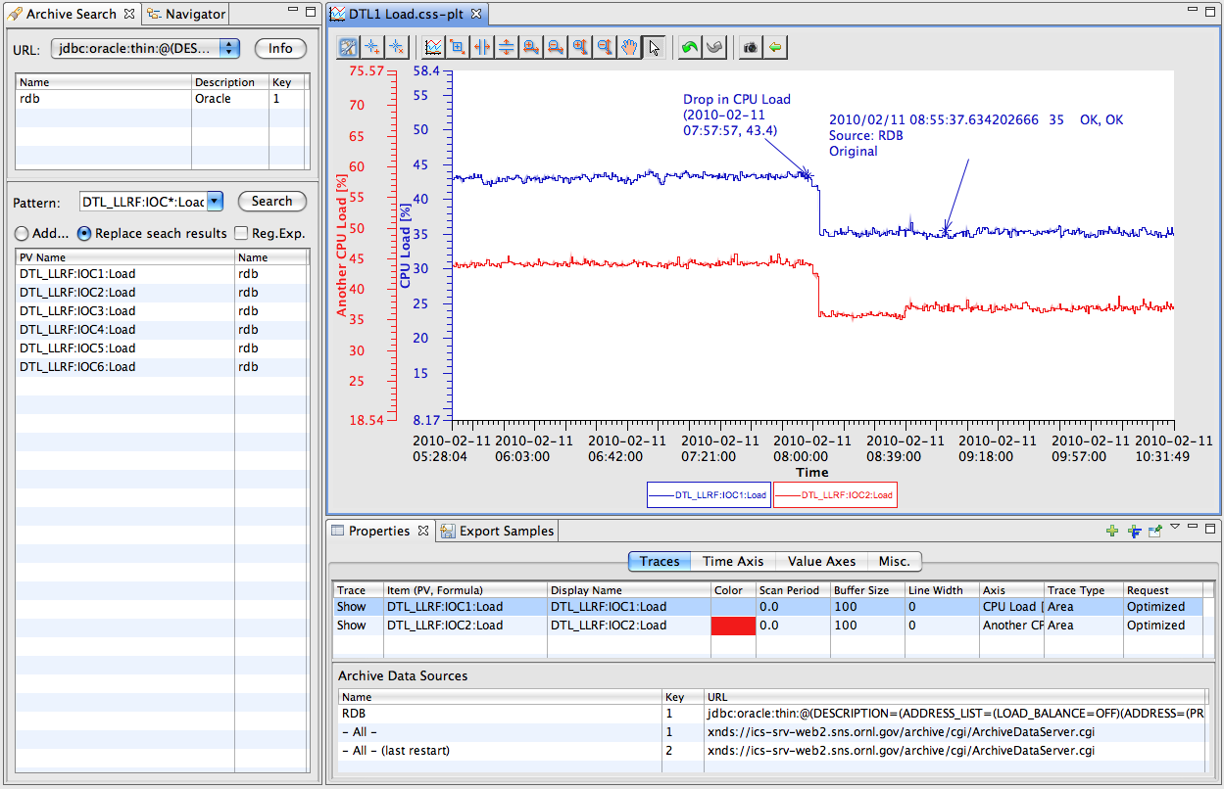
Data Browser
Plot ‘live’ and ‘archived’ data over time

Slide 20
Support for Historic Data Sources

Slide 21
Alarm System (BEAST)
Tabular or Tree view, voice annunciations, …
Select by Name, Description
Acknowledge
Sort by Time, Severity, …

Slide 22
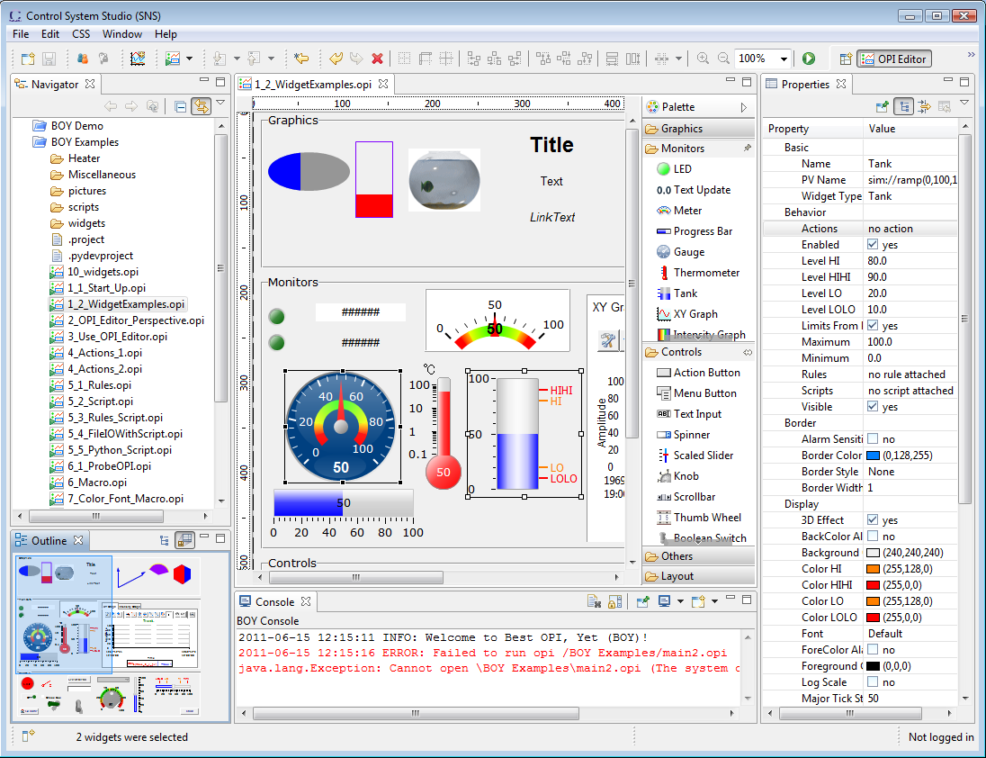
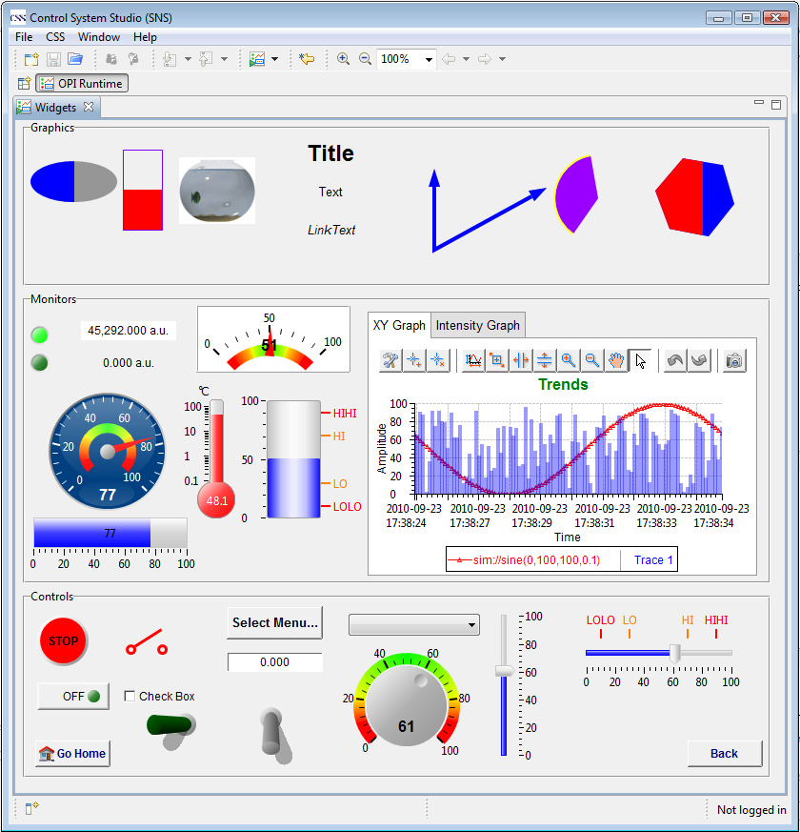
BOY – Best OPI, Yet
Operator Interface Editor Runtime
Select widget, enter PV name, done
No programming, no compilation, …

Slide 23
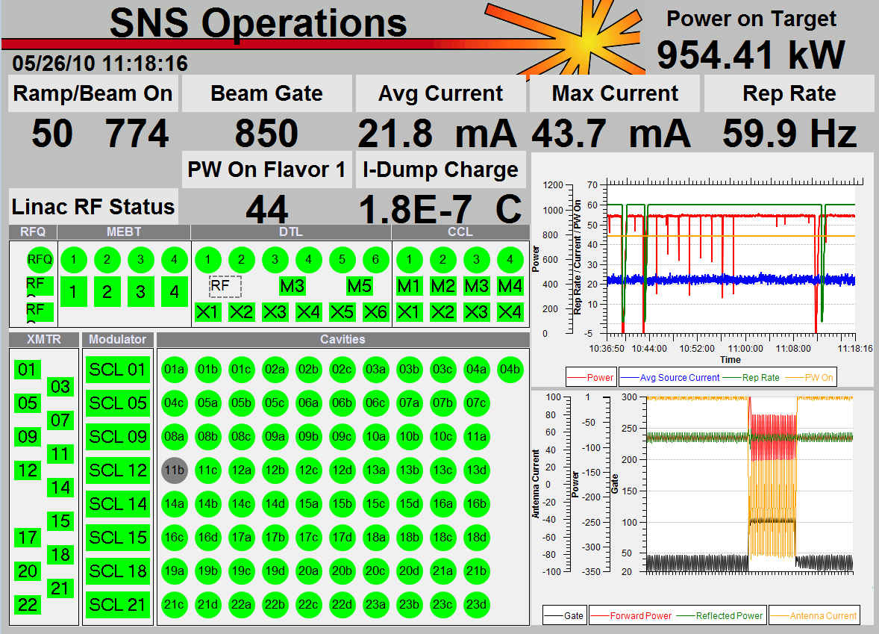
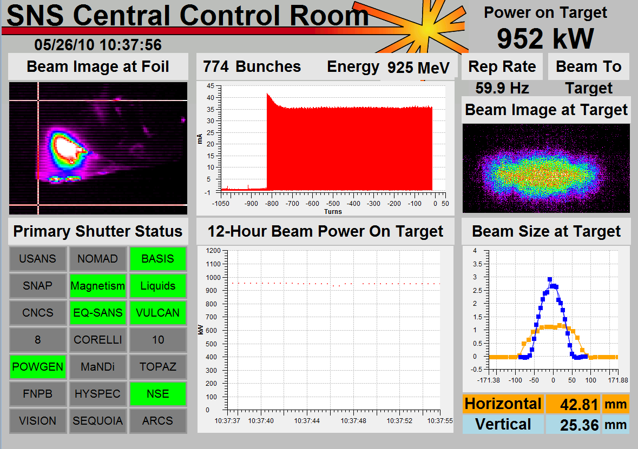
SNS OPI Examples
Top-level displays created by operators
Tim Southern, Nick Luciano

Slide 24
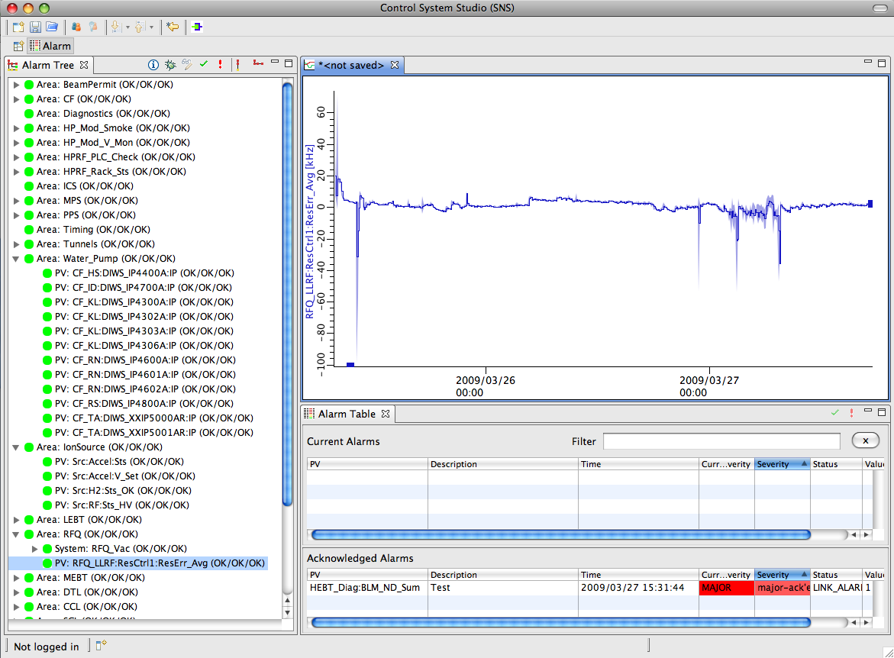
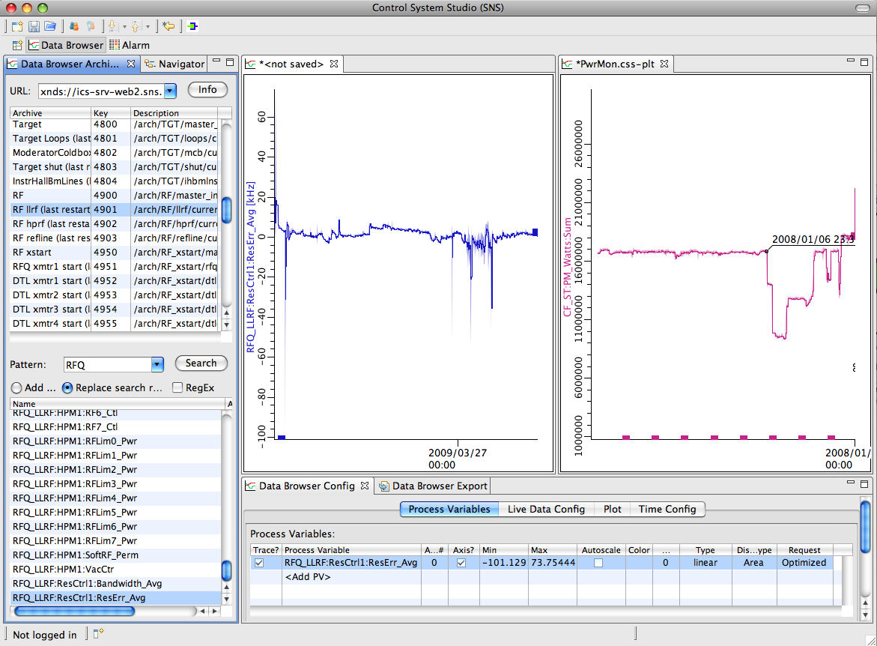
Flexible Layout
Panels can be closed, reopened, repositioned
Multiple Perspectives
Name, Save, Restore
Multiple document instances share same configuration panels

Slide 25
CSS PV Exchange
PV in any CSS Tool ➔ Context Menu ➔ Select other PV Tools
Opens other tool with that PV

Slide 26
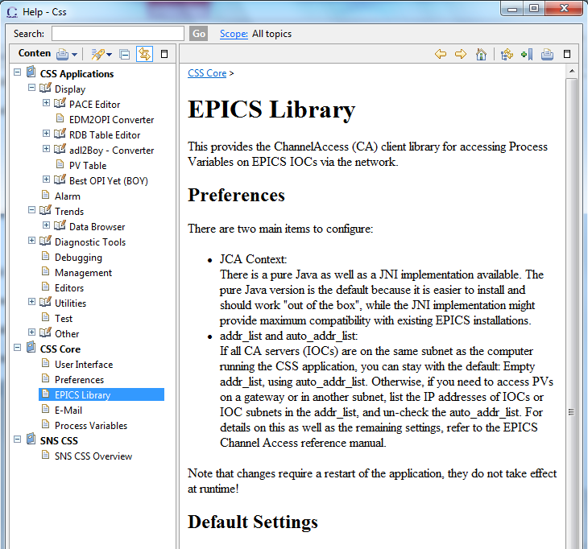
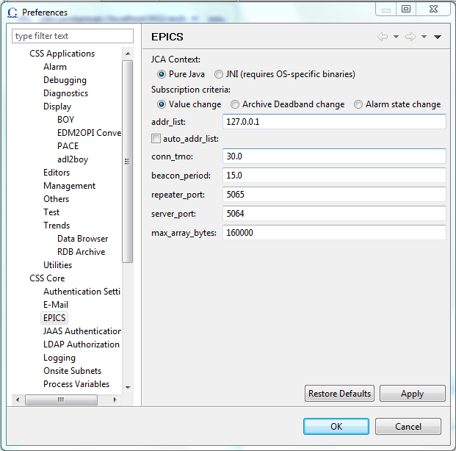
Integrated Help, Preferences
Uniform access to settings, searchable help
Applications
Support Libraries
Logging
Control System access

Slide 27


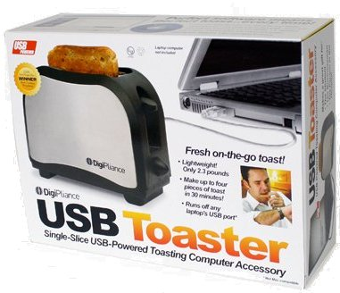

Thick Client vs. Web
CSS: Integrated, rich, portable
Still: Needs to be installed on each user’s computer..
Accessible from phones, tablets, toasters?
OK, nobody asked about the toaster, yet.
But it’s getting there, see www.theonion.com

Slide 28
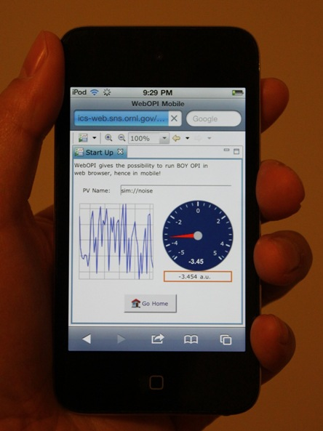
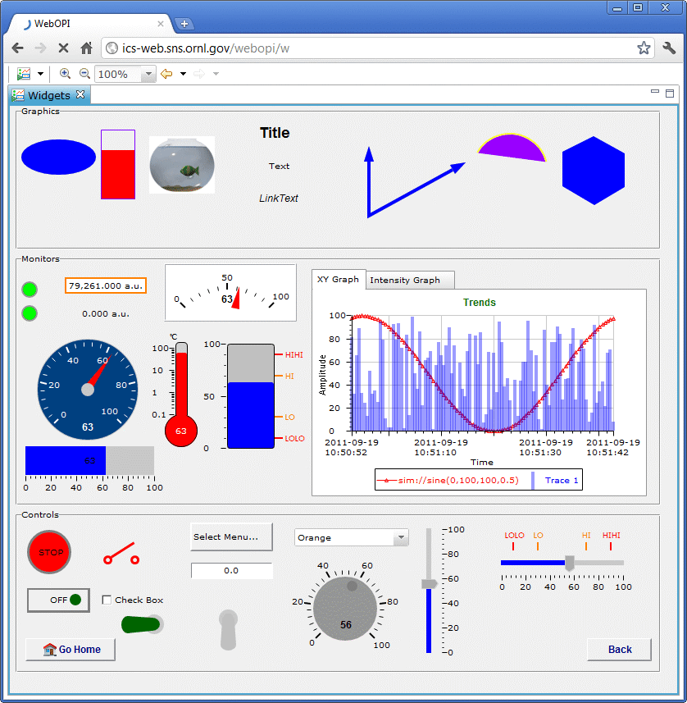
Web OPI
CSS is Desktop app, will probably remain so, but
*.opi files can be viewed online!

Slide 29
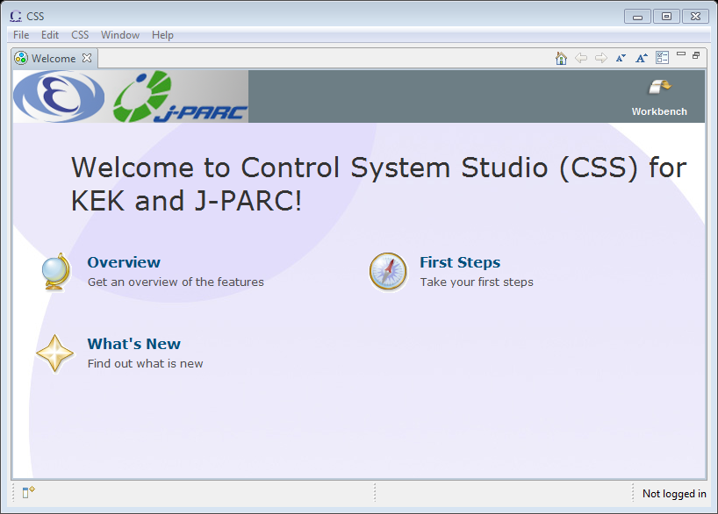
Site-Specific Setup
Product: Tools and settings for your users at your site. Decide which parts of CSS you need.

Slide 30
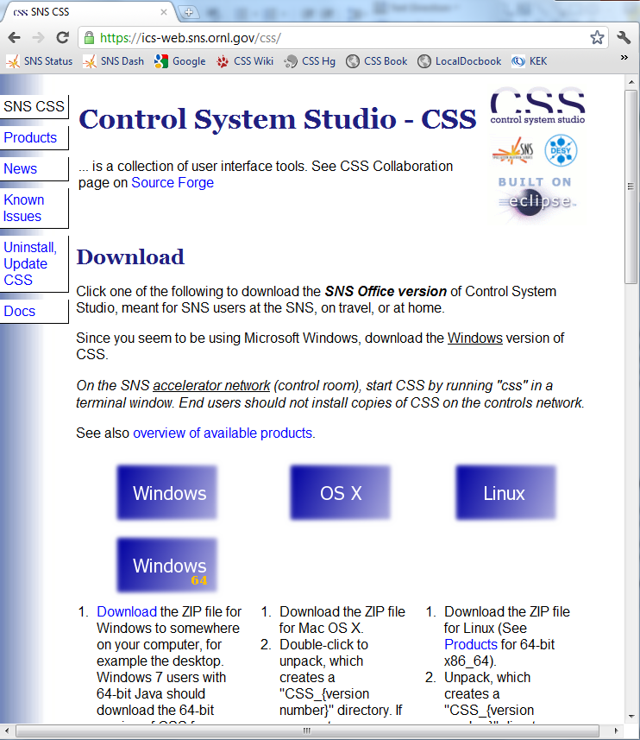
Site-Specific Setup
Product for your users
Web site: Initial download

Slide 31
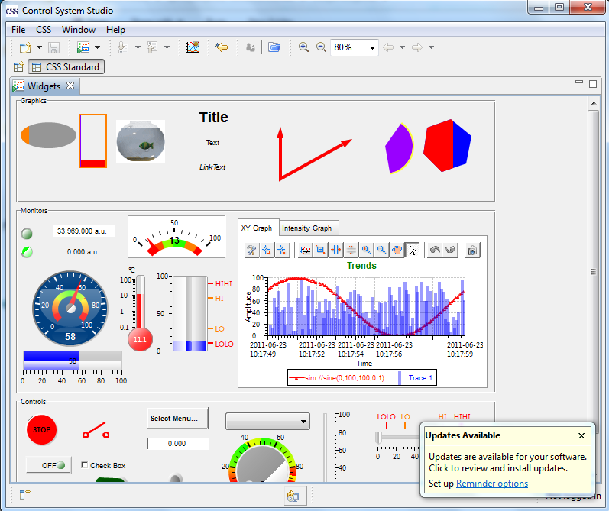
… Site-Specific Setup
Product
Web site
Automated updates

Slide 32

Need Site-Specific Setup
Developer:
End User: Happy
Steep Learning Curve for Developers
… but also many Books, online Tutorials
Invest to learn it, and you’ll like it

Slide 33
Summary -- What is CSS?
Excellent for end-users:
An Integrated Control System Tools Workbench
To Developers:
A Framework
An Architecture
A Toolkit
A Collaboration
http://www.wendolene.co.uk/Pictures/Happy.jpg
http://www.citytowninfo.com/images/education-articles/how-to-become-a-software-engineer-2.jpg

Slide 34
Thank you!
CSS
Basic EPICS CSS Products to try: http://ics-web.sns.ornl.gov/css/products.html
Guide book, source-to-product: http://cs-studio.sourceforge.net/docbook/
CSS Wiki: http://sourceforge.net/apps/trac/cs-studio
Eclipse
http://www.eclipse.org/

